Slide 1
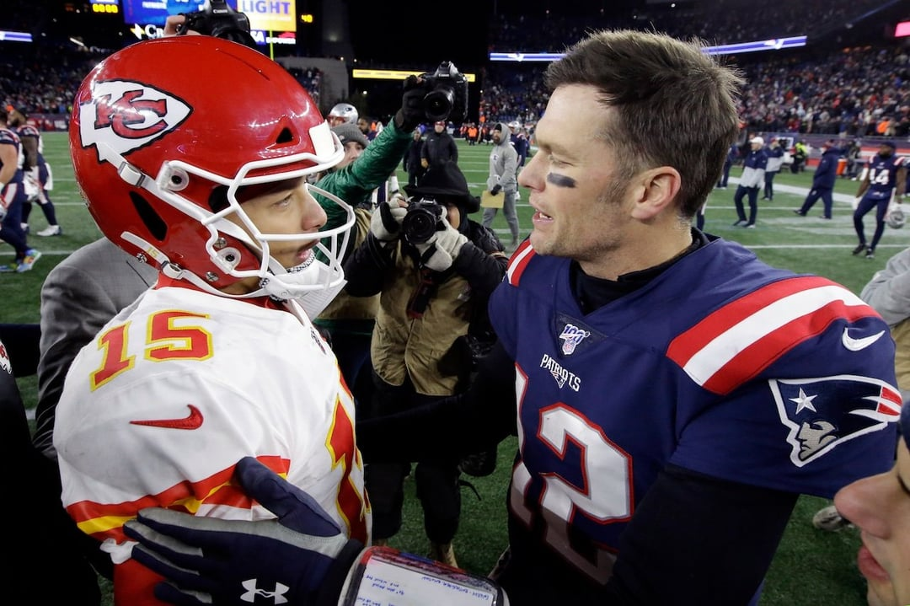
Forecasting
The GOAT with
Artificial Intelligence
AI Forecasts How the Tom Brady vs Patrick Mahomes Debate Will End

